Slide 1

Using LEGO Robots to Create Smileys
M. Ali Yousuf
mali@jhu.edu
61st Annual NAGC Convention, November 15, 2014
Baltimore, Maryland

Slide 2
Presentation Meant for
K-6-8 Teachers as class room activity

Slide 3
Some Definitions
MINDSTORMS
AUTISM

Slide 4
Contents
Motivation
Perception of Facial expressions
Mindstorms ++
Conclusions

Slide 5
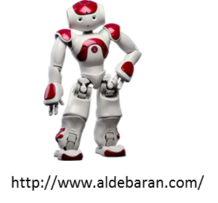
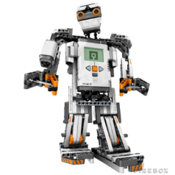
Motivation
Robots for Autistic Kids in Mexico, 2008 [Self]
Robots in Autism Therapy, 2013 [2,3]
Artificial Emotions to Assist Social Coordination in HRI, 2012 [1]
A course on Robotics and Psychology at CTY? 2013
http://www.lego.com/
LEGO to express emotions?

Slide 6
2. Human Facial Expressions
We now discuss some of the human facial expressions that can be represented as ‘smileys’.
But
How many facial expressions are there?
How many are universal?
How many are recognizable by kids?
Starting from what age?
Do learning disabilities change this pattern?
…

Slide 7
2. Human Facial Expressions
The 21 Human Facial Expressions [9]
Happy
Sad
Fearful
Angry
Surprised
Disgusted
Appalled
Hatred
Awed
Sadly angry
Sadly surprised
Sadly disgusted
Sadly fearful
Happily surprised
Happily disgusted
Fearfully angry
Fearfully surprised
Fearfully disgusted
Angrily surprised
Angrily disgusted
Disgustedly surprised

Slide 8
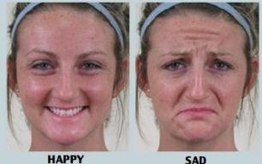

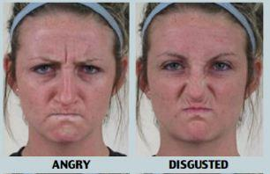
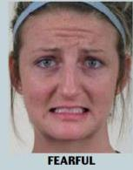
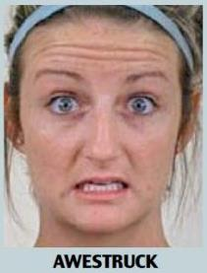
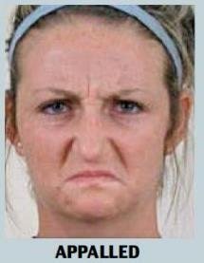
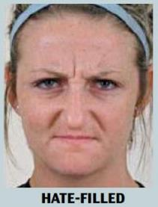
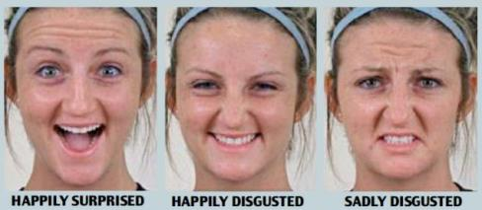
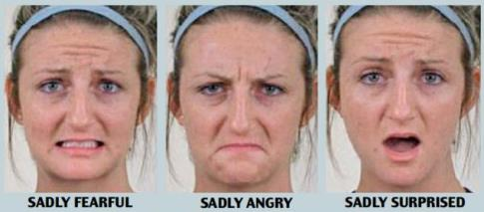
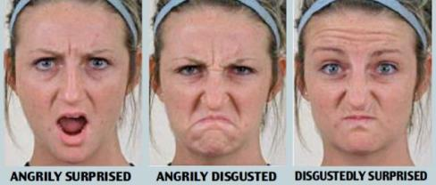
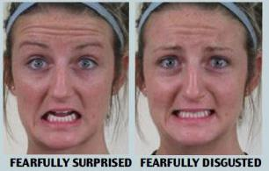


Slide 9
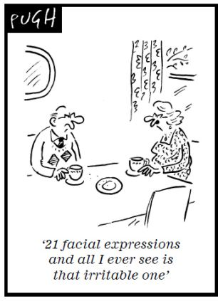

Slide 10
2. Human Facial Expressions
How many facial expression can you name?
Happy
Sad
Angry
Surprised
What else?
Facial expressions typically classified as universal are joy, surprise, anger, sadness, disgust and fear [7].

Slide 11
2. Human Facial Expressions
How do normal kids see facial expressions?
There are significant differences in a pre-school child’s ability to recognize and match the four different expressions: happy, sad, surprised, and angry (74% overall accuracy)
Young children match happy expressions with the same frequency as sad.
Sad faces are matched more frequently than surprised, or angry expressions [10].

Slide 12
2. Human Facial Expressions
What about autistic kids? (Human and robotic face)
Results of another study show that the robot’s “face” and “moving limb” usually draw the autistic children’s attention and improve their facial expression skills, but do not contribute to the development of other social communication skills [8].
Test results show that children interacted with the verbal‐featured robot more intensively than with the experimenter. Hence robots with faces and moving limbs can engage autistic children in a better way.

Slide 13
2. Human Facial Expressions
So much so for facial expressions and our ability to recognize them.
Now let’s see how to replicate them with a low cost LEGO Mindstorms
The question is how many of these expressions can be represented in LEGO with minimum complication in design and control

Slide 14
2. Human Facial Expressions
Start with Mona Lisa Eyes
☺ ☹

Slide 15
2. Human Facial Expressions
Start with Mona Lisa Eyes
☺ ☹

Slide 16
2. Human Facial Expressions
That’s a good start but we need more basic facial expressions.
Let’s try more types of eyes and lip configurations.
Two types of eyes and three lip configurations give us 3 x 3 or nine possible faces:

Slide 17
Lips → Happy neutral sad
Mona Lisa
Eyes?
Happy
Sad
Surprised

Slide 18
3. Mindstorms++
Step 1: Children were given the basic pieces to try to connect them to represent lips in different configurations
Step 2: Process repeated for different types of eyes
Step 3: Finally they combined the above two to represent different face expressions like a smiling or sad face

Slide 19
3. Mindstorms++
Step 4: The designs were then revised by an adult to make them suitable for motor control
Step 5: Students were given basic instructions on LEGO programming
Step 6: Students created final designs with facial expressions which can change (by pressing a button, for example)

Slide 20
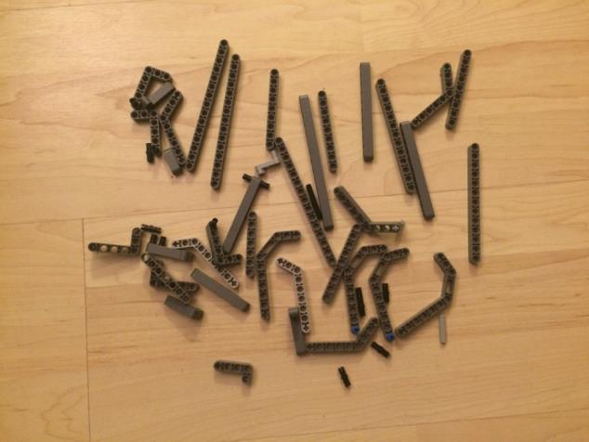
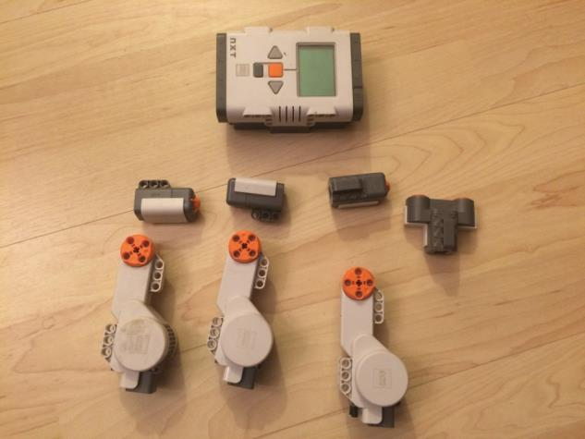
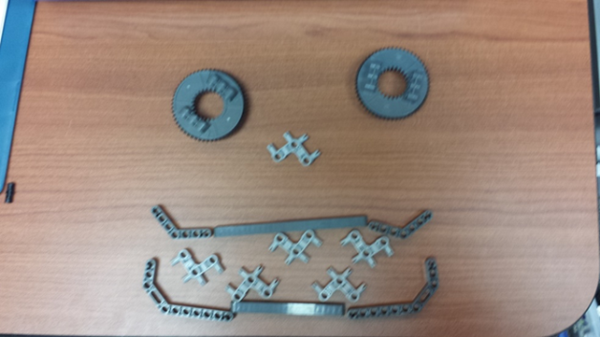
3. Mindstorms++
Some of the basic material needed for facial expressions
Addition of motors and some sensors make it more interesting

Slide 21
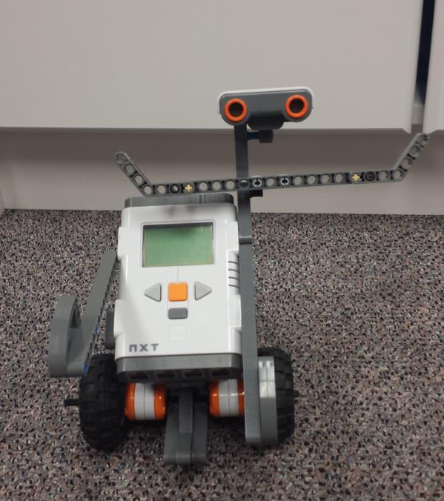
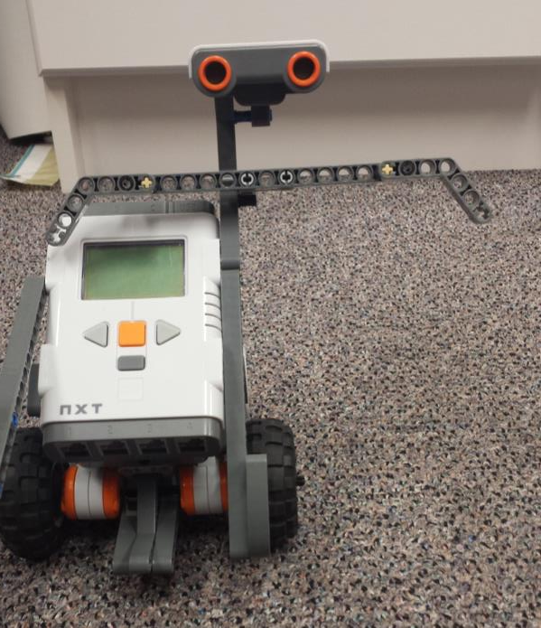
3. Mindstorms++

Slide 22
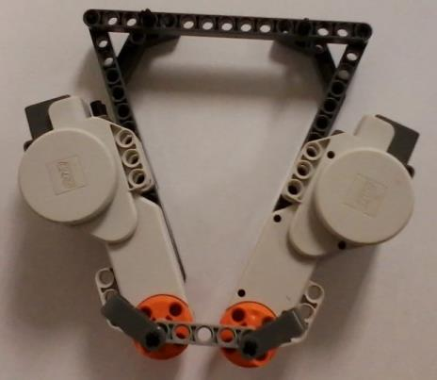

Slide 23

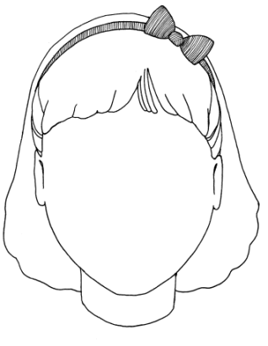

3. Mindstorms++
Step 7: Simple face ‘contours’ were added to increase effectiveness

Slide 24
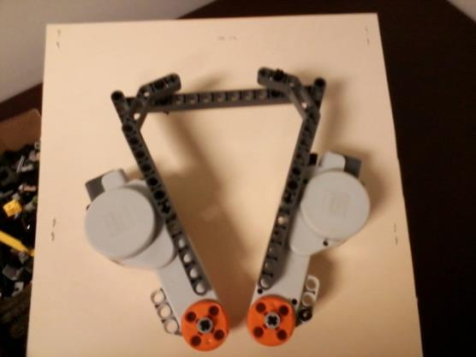
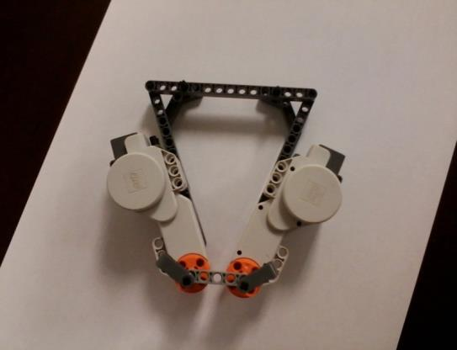
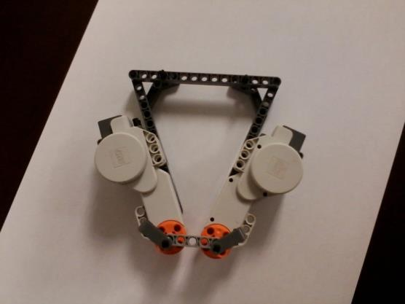
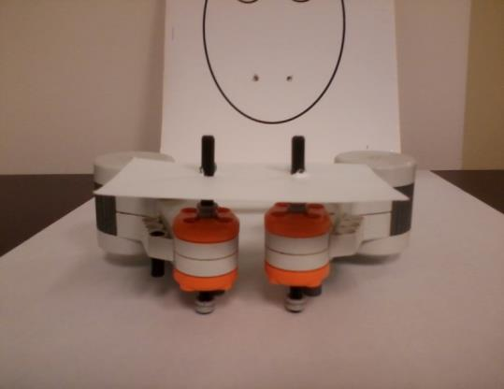
Behind the Scene

Slide 25
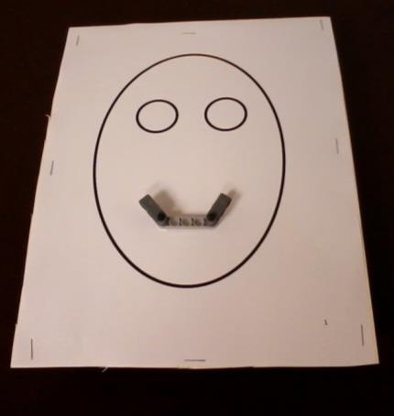
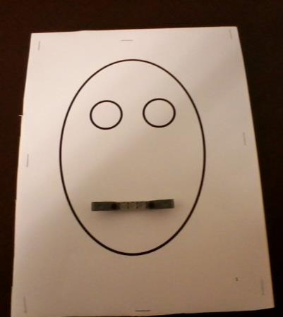
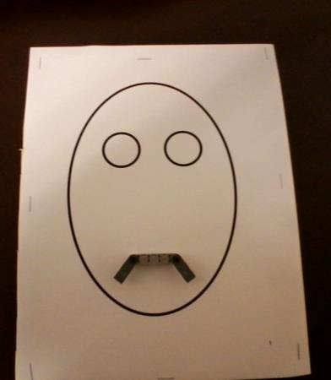
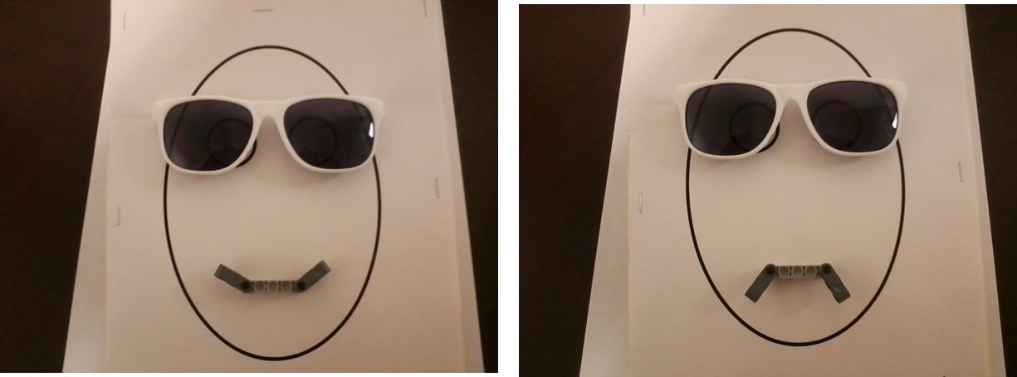

Slide 26
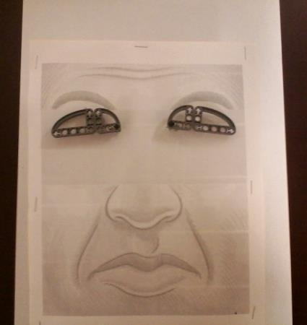
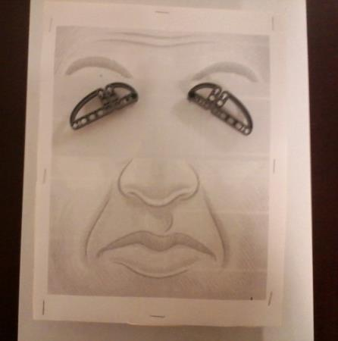
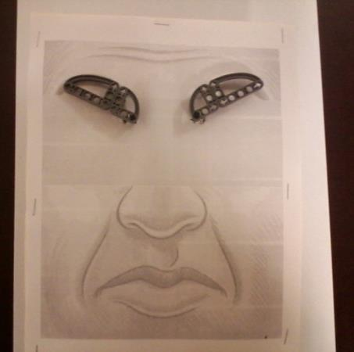
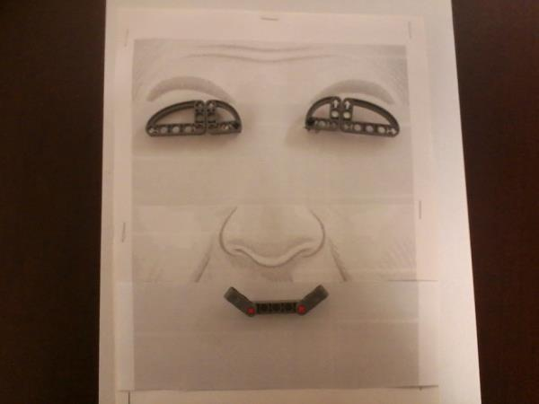
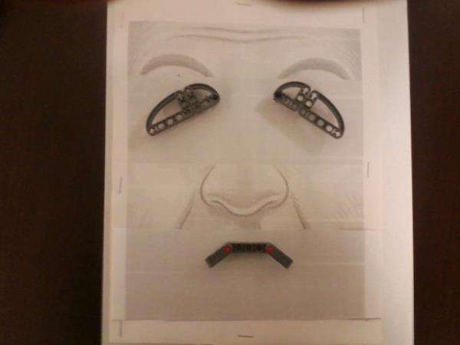

Slide 27
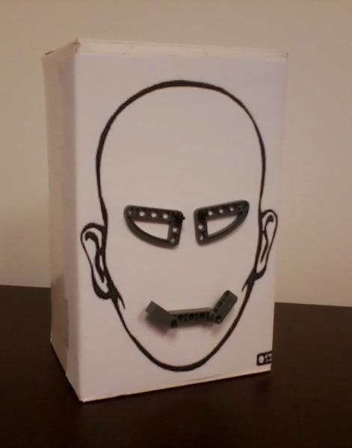
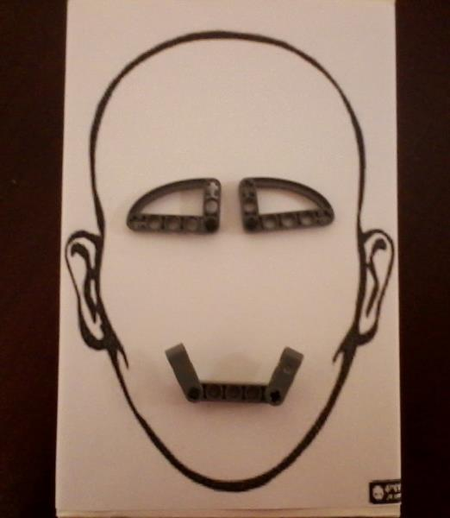
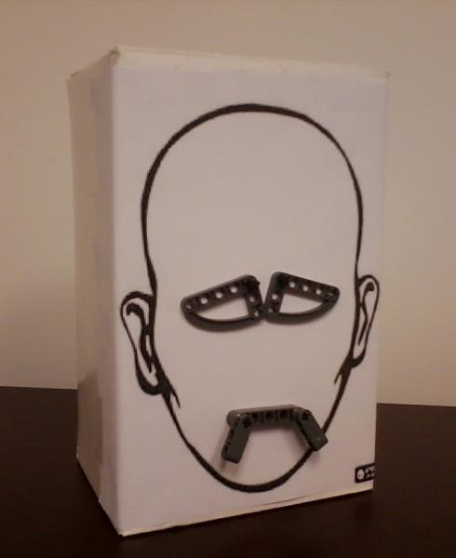

Slide 28
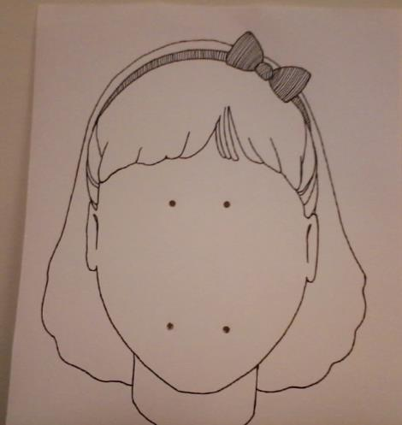
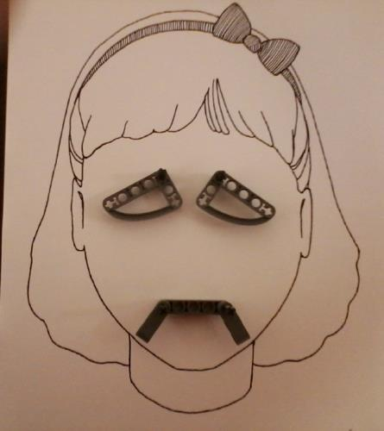
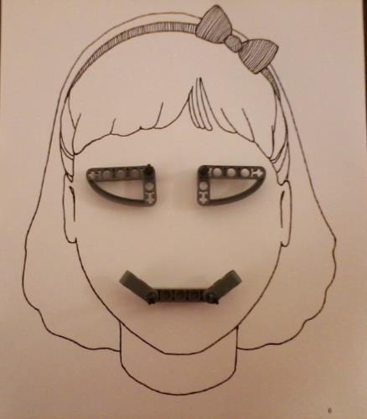

Slide 29
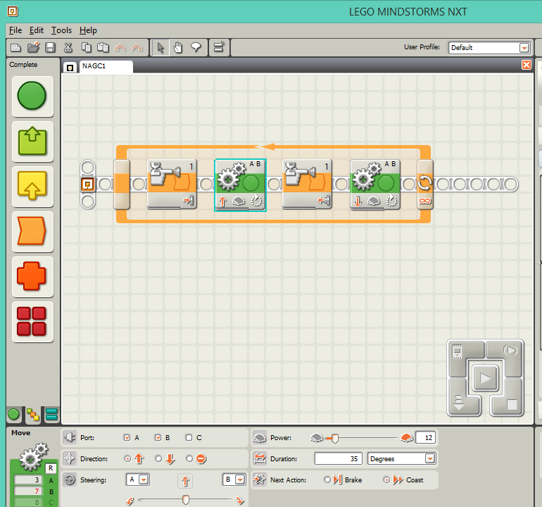

Slide 30
3. Mindstorms++
Adding neck position for reinforcement
Images removed due to copyrights. Please see reference [1]
Lego robot, expressing artificial emotions with the addition of two basic neck movements (forward and backwards) [1]

Slide 31
4. Conclusions and More Ideas (1/3)
We have shown that even simple construction material can be used to represent facial expressions.
At least some of the universal expressions can be interpreted by students.
Only very basic designs were tried due to the age group of children. Elder students can design much more complicated faces and can program more intelligent behaviors

Slide 32
4. Conclusions and More Ideas (2/3)
The addition of movements using robotic motors adds more dimensions and makes it even easier to understand expressions.
There are two immediately obvious directions for further work: More movements and more sensing.
Just one sided movements
Neck movements
More types of eyes and more complicated lips

Slide 33
4. Conclusions and More Ideas (3/3)
More sensing:
It is possible for these robots to ‘react’ to certain actions or noises. These reactions may mimic actual human reaction (Like KISMET Robot)
Ex: Wave hand in front of Ultrasonic Sensor to make it smile
Color detection and changing expressions
Further experimentation is required to see how student’s age, gender, education level, etc affect perception of facial expressions [6].

Slide 34
References
[1] Jekaterina Novikova, Leon Watts, Artificial Emotions to Assist Social Coordination in HRI, Workshop on Embodied Communication of Goals and Intentions at the International Conference on Social Robotics (ICSR) 2013,
[2] Daniel J. Ricks and Mark B. Colton, Trends and Considerations in Robot-Assisted Autism Therapy, 2010 IEEE International Conference on Robotics and Automation, Anchorage Convention District, May 3-8, 2010, Anchorage, Alaska, USA
[3] Davies, S., Bishop, D., Manstead, A. S. R. and Tantam, D. (1994), Face Perception in Children with Autism and Asperger's Syndrome. Journal of Child Psychology and Psychiatry, 35: 1033–1057. doi: 10.1111/j.1469-7610.1994.tb01808.
[4] Albo-Canals, et.al., Comparing two LEGO Robotics-Based Interventions for Social Skills Training with Children with ASD, 2013 IEEE RO-MAN: The 22nd IEEE International Symposium on Robot and Human Interactive Communication, Gyeongju, Korea, August 26-29, 2013
[5] Jaeryoung Lee, Hiroki Takehashi, Chikara Nagai1, Goro Obinata and Dimitar Stefanov, Which Robot Features Can Stimulate Better Responses from Children with Autism in Robot-Assisted Therapy? Int J Adv Robotic Sy, 2012, Vol. 9, 72:2012
[6] Tedra A. Walden and Tiffany M. Field, Discrimination of Facial Expressions by Preschool Children, Child Development, Vol. 53, No. 5 (Oct., 1982), pp. 1312-1319
[7] P. Ekman and W.V. Friesen, Pictures of Facial Affect. Consulting Psychologists Press, Palo Alto, CA, 1976.
[8] J Lee, et.al., Which Robot Features Can Stimulate Better Responses from Children with Autism in Robot-Assisted Therapy? Int J Adv Robotic Sy, 2012, Vol. 9, 72:2012
[9] S. Du, Y. Tao, A.M. Martinez, Compound Facial Expressions of Emotion, Proceedings of the National Academy of Sciences 111 (15) E1454-E 1462, 2014
[10] T A Walden and T M FieldSource, Discrimination of Facial Expressions by Preschool Children Child Development, Vol. 53, No. 5 (Oct., 1982), pp. 1312-1319

Slide 35
Questions?
Dr. Muhammad Ali Yousuf
Assistant Program Manager
Summer Academic Programs
Center for Talented Youth
Johns Hopkins University
McAuley Hall, 5801 Smith Avenue, Suite 400
Baltimore, MD 21209
Phone (Off): 410-735-6523
Fax: 410-735-6187
mali@jhu.edu
http://www.linkedin.com/in/maliyusuf
http://cty.jhu.edu

